Slide 1
Bearing fault diagnosis with non-stationary speed and load conditions
Salma BERRADA Co-author, Roger SERRA Co-author,
Piet van DALEN Co-author, Céline CHASTAGNER Co-author
SKF Netherlands,
SKF France,
Institut National des Sciences Appliquées Centre Val de Loire,
Laboratoire de Mécanique Gabriel Lamé - EA 7494,
Blois, France,
salma.berrada@insa-cvl.fr /roger.serra@insa-cvl.fr /Piet.van.dalen@skf.com /Celine.chastagner@skf.com

Slide 2
Plan
Background
I- Variable rotation speed and constant load :
Campbell diagram
order analysis
II- Stationary rotation speed and variable load
III- Bearing signals after dismounting and visual inspection of the bearings
Conclusion

Slide 3
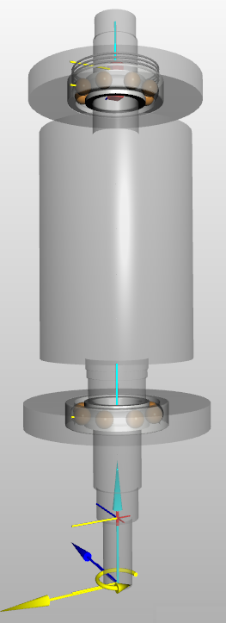
Background
2 NVH measurements were performed on a e-vehicle motor:
This study will focus on the First test under run up conditions with stationary load and variable speed on new unit and after fatigue test (after simulating 56 000 Km)
Second test is performed with stationary speed and variable load
The measurements were performed with 3-ax accelerometers:
X: radial direction (with respect to the shafts and bearings; towards reader)
Y: axial direction (with respect to shafts; left/right)
Z: tangential direction (up and down)
Data is provided in CSV format :
Sampling rate is 20480Hz to fit all data in CSV file
1 file provide with 48kHz to see higher frequencies
Gear box:
Sensor position Bearing L1
Sensor position Bearing L2
Gearbox
With 3 shafts
E-motor
Z1
26

Slide 4
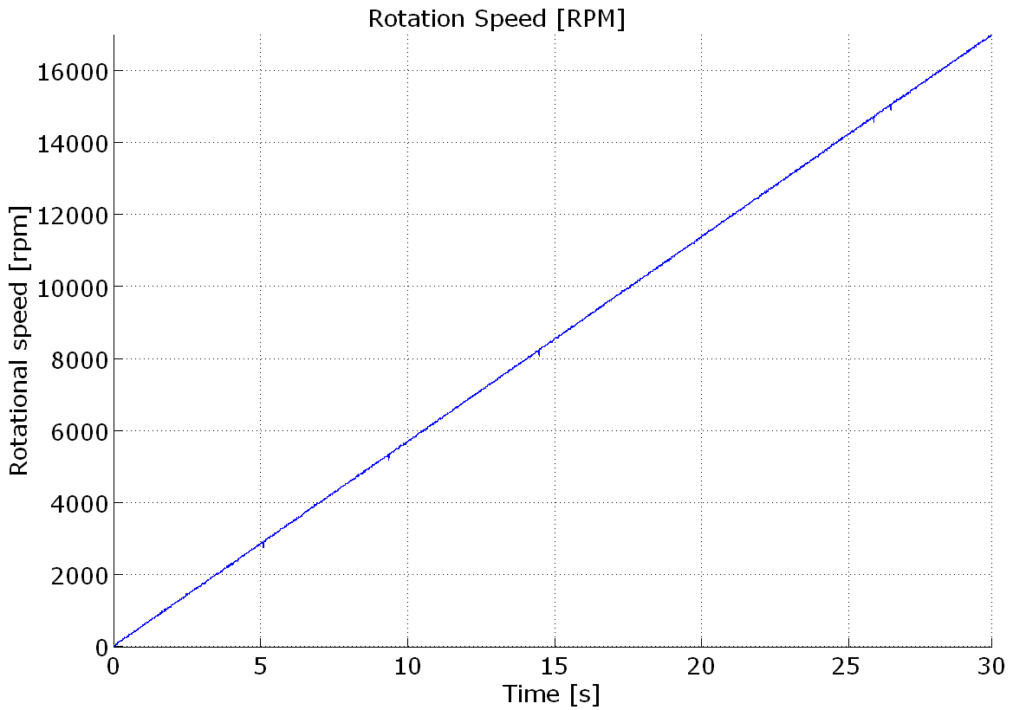
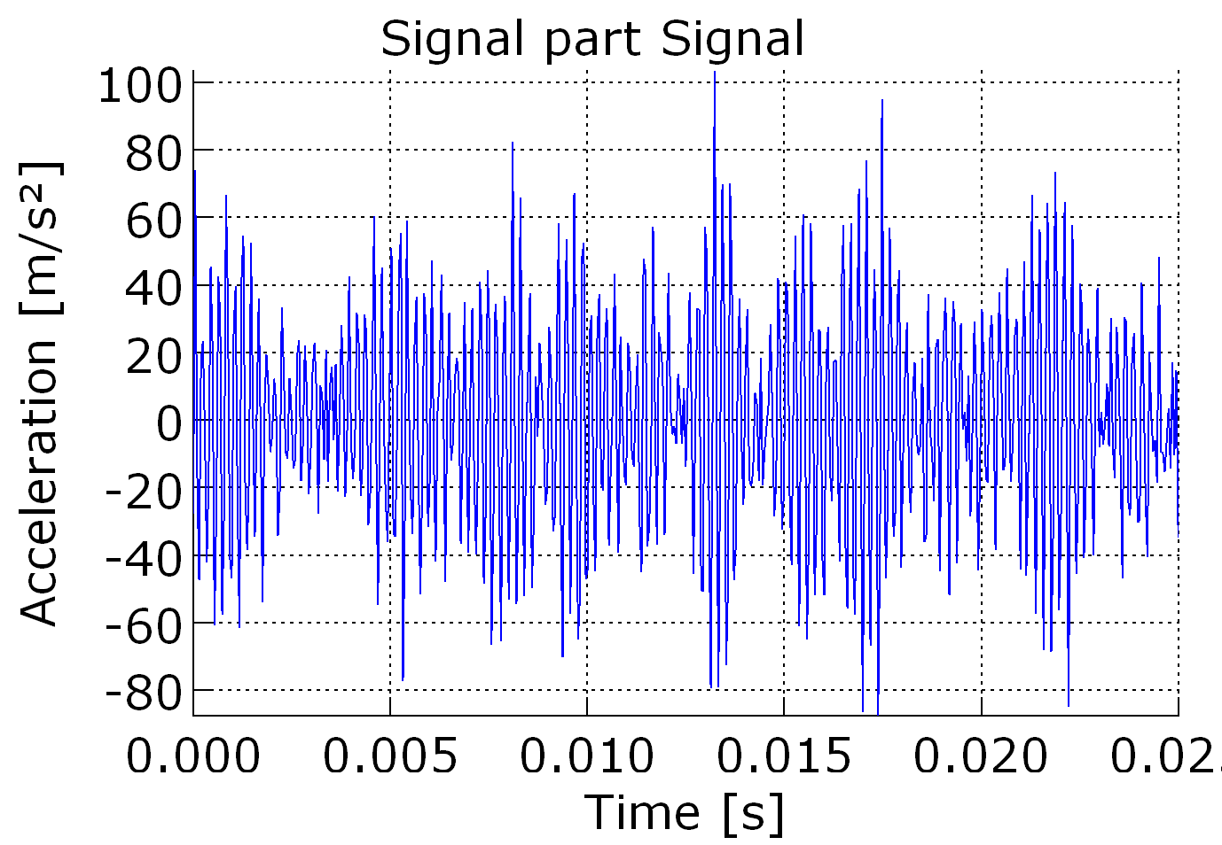
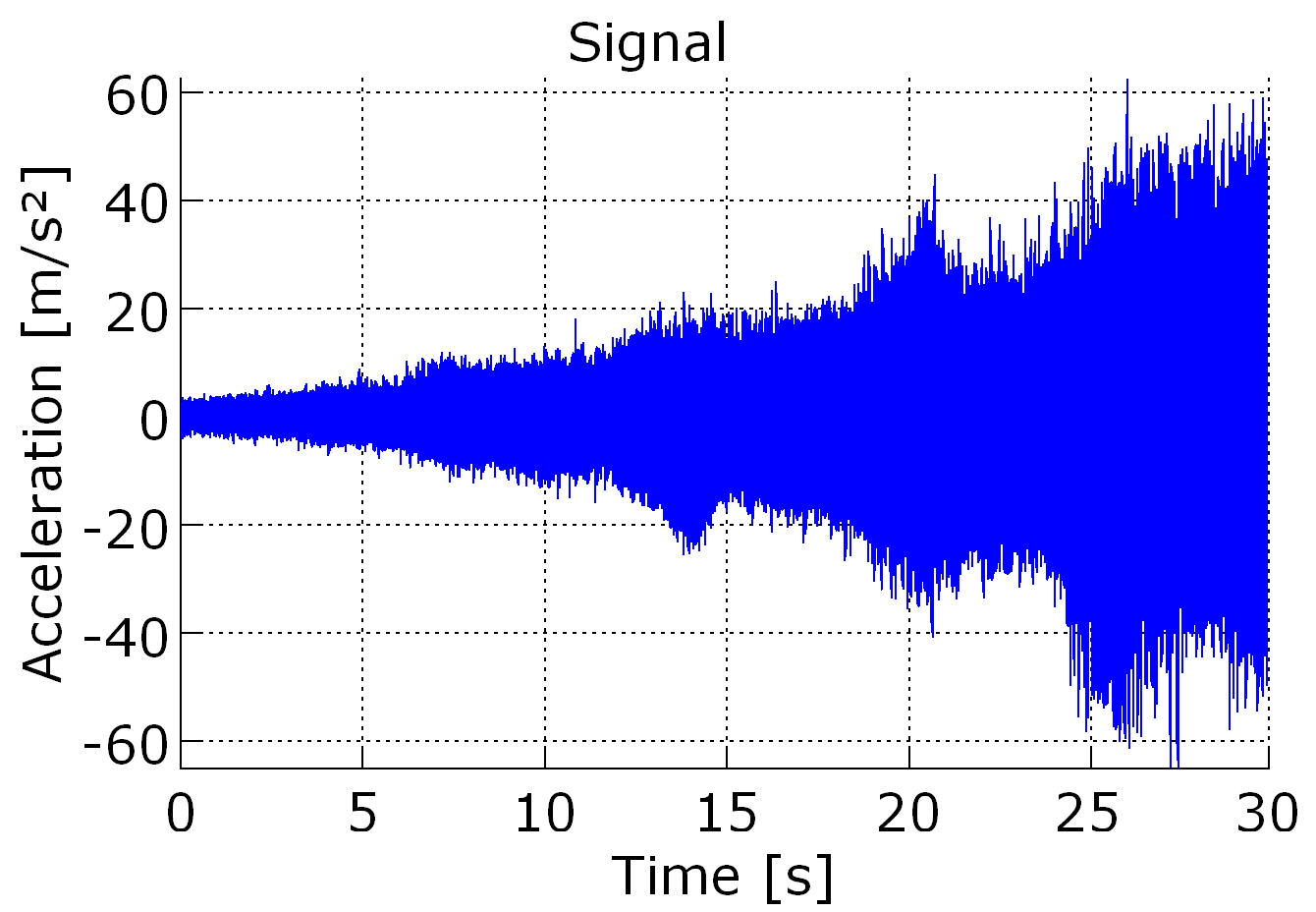
I- Variable rotation speed and constant load
L1 bearing : Recorded data go up to 17kRPM as shown in the graph,
Torque 10Nm
Sampling rate is 20480Hz

Slide 5
Campbell Diagram
L1 bearing X direction new unit
Natural frequencies
RPM harmonics
Notes:
Creates a rotational speed versus frequency analysis. This is a spectrogram (time versus frequency) with the time axis replaced by a rotational speed axis that is derived from a tacho meter signal. A run-up measurement as well as a coast-down measurement can be analysed.

Slide 6
I- Variable rotation speed and constant load
L2 bearing : Recorded data go up to 17kRPM as shown in the graph,
Torque 10Nm
High sampling rate 48kHz shows the main frequencies present:
RPM harmonics
Gear freq with RPM side-bands (order analysis in next slide)
Natural frequencies around 5 and 6kHz excited by several sources
VFD electrical frequencies
Carrier Frequency: 10kHz
L2 bearing X direction new unit
VFD electrical frequencies
Natural frequencies
Gear freq 26xRPM
RPM harmonics
Notes:
During the run-up there are two moments in time in which the vibrations increase significantly (around 19 and 23 sec).
This is when the gear mesh with RPM side-bands crosses two natural frequencies creating a resonance.

Slide 7
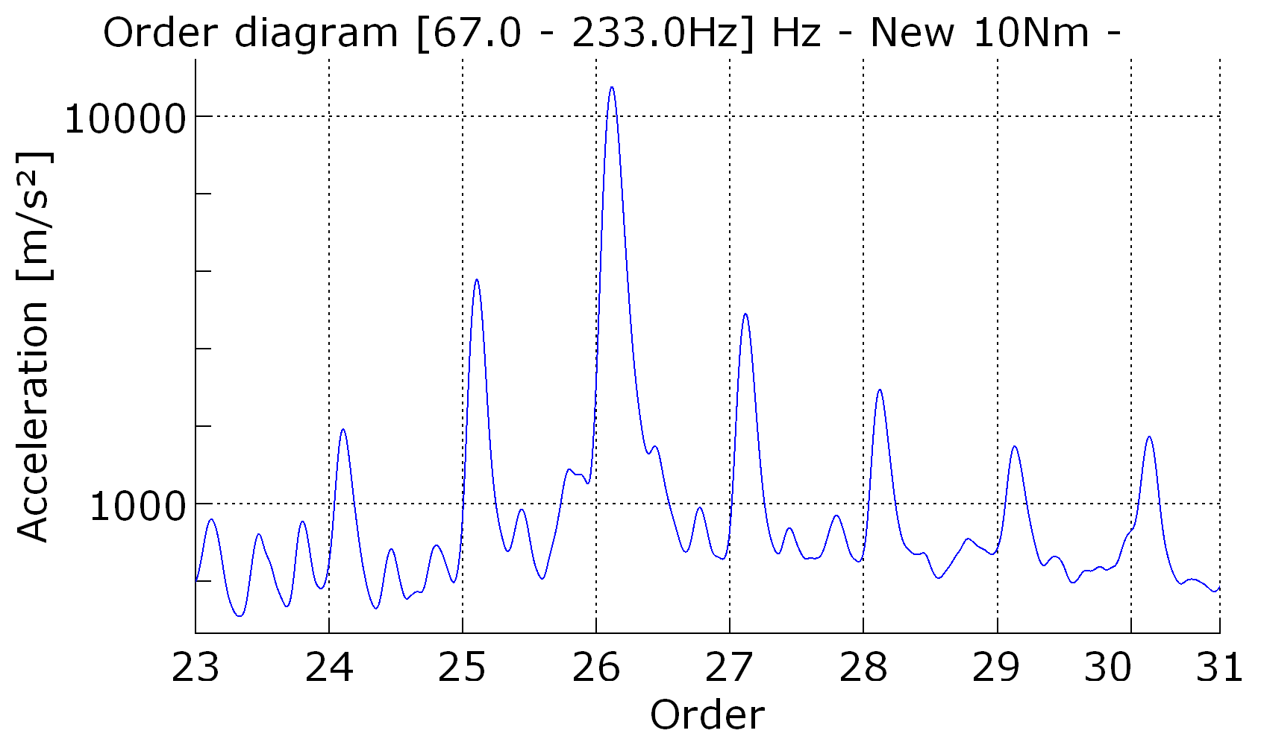
Order analysis
Gear freq 26xRPM
RPM Side bands

Slide 8
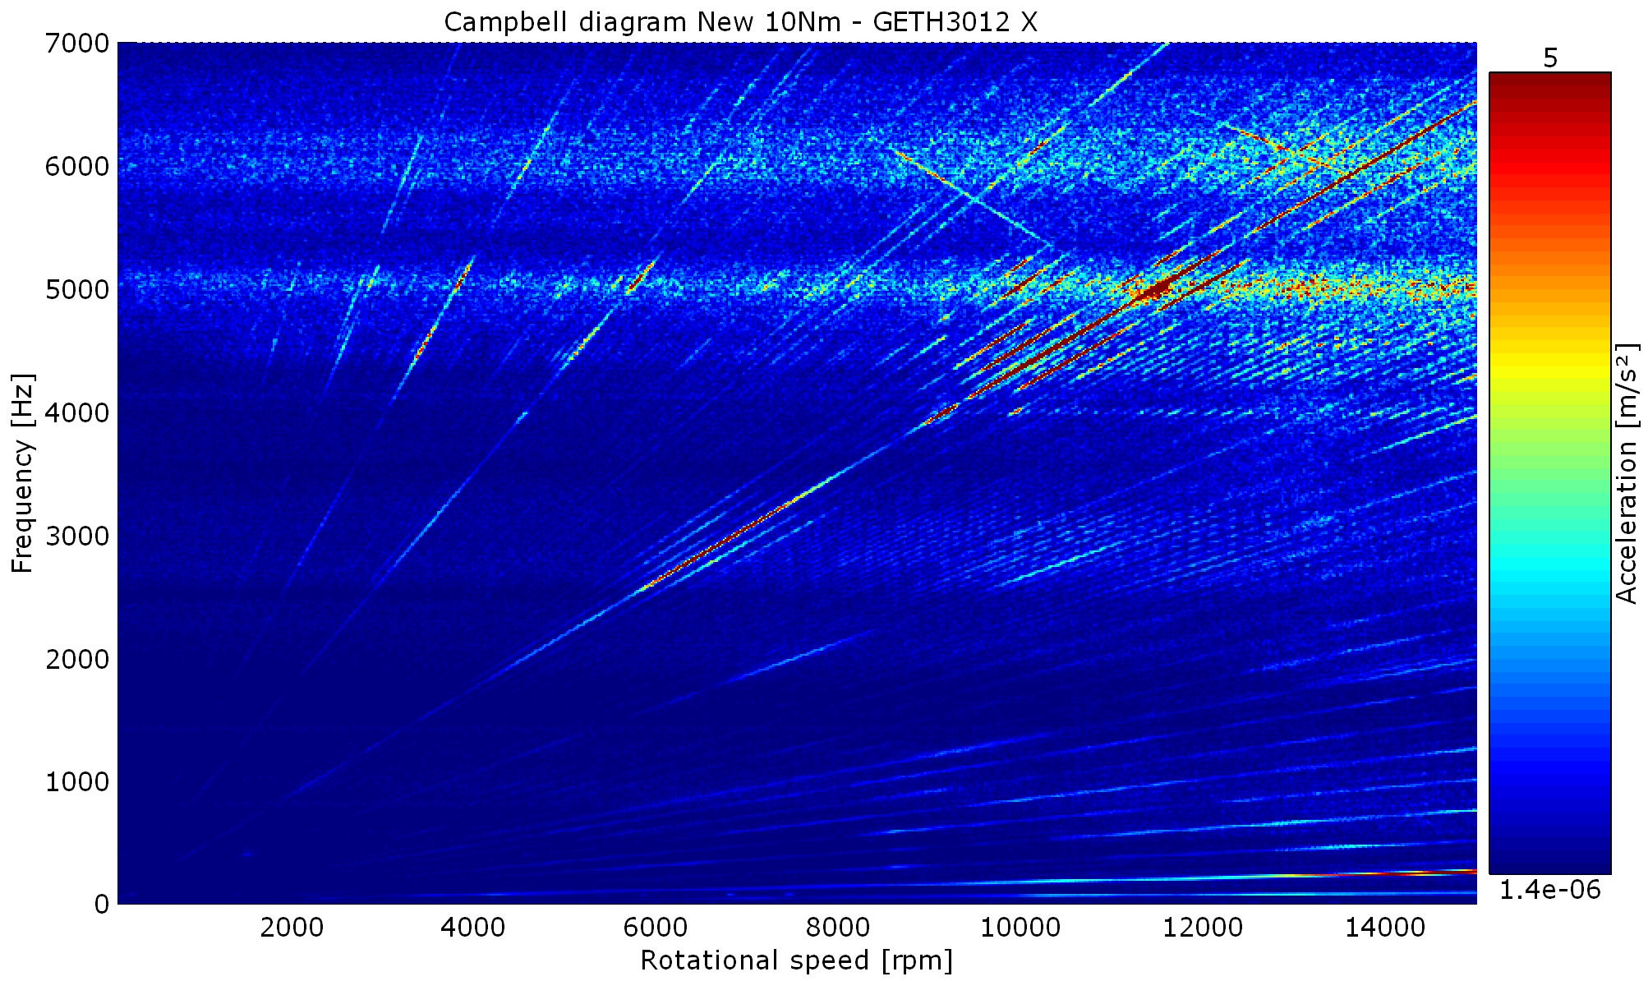
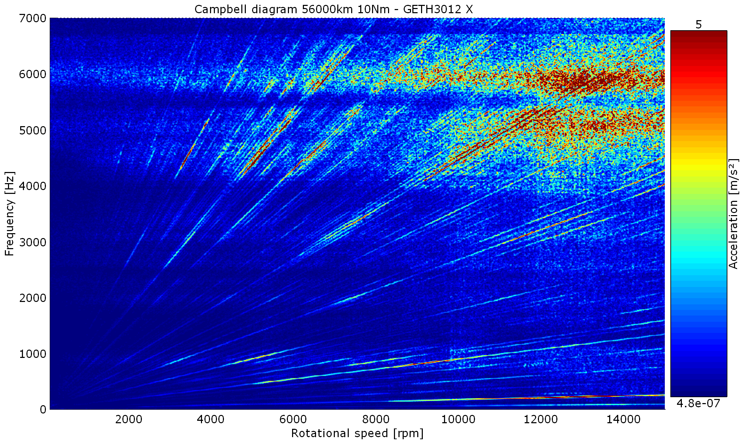
New versus 56000km - 10Nm
Comparing the 56000km measurement with new unit, it can be concluded that vibrations increased. Order lines have higher amplitudes, and resonances are more clearly present
New
56000km

Slide 9
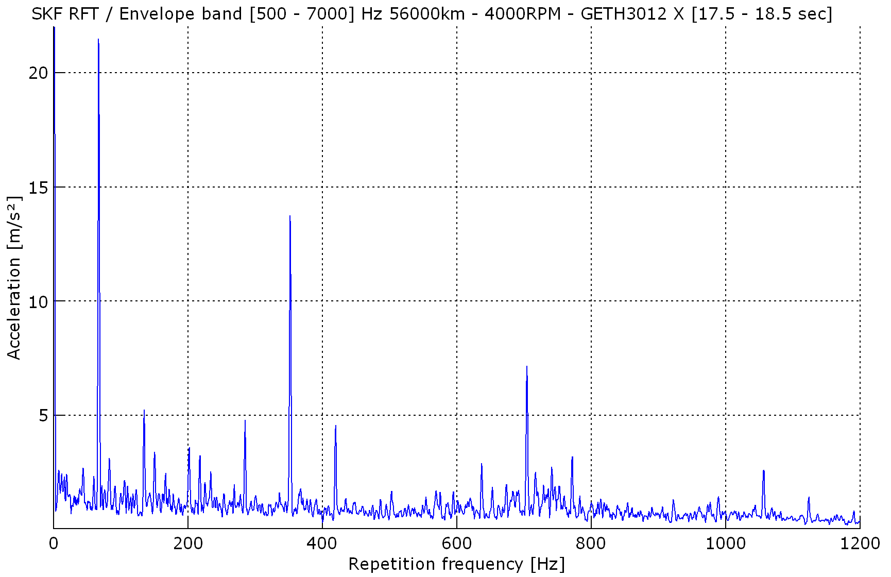
stationary rotation speed at 4000RPM- 56000km
There is a peak at 352Hz with higher harmonics with RPM side-bands => There should be a pulse like source that generates these peaks
Two bearing frequencies are close:
L1 ORD: outer ring defect but ORD should not have RPM side-bands
L2 RED: rolling element defect but RED should have only cage side-bands
=> These peaks could maybe correspond to bearing defect if the defect is very large (spall) this might be a possibility. Visual inspection of bearing L1 & L2 should confirm this.
RPM
352Hz
2x352Hz
2xRPM
RPM side-bands
3x352Hz
Notes:
Method to analyse repetitive pulse events like bearing defects. It is similar to the Envelope techniques but is more general and more sensitive to small defects. It has been developed by SKF. First an spectrogram is computed with the STFT algorithm. As a second step, FFTs are applied over every frequency (so along the time axis). This reveals repeating patterns with certain repetition frequencies. Hence the result is a 2D plot with on the x-axis the repetition frequencies and on the y-axis the frequency content of the pulses.
Bearing defects/scratches are difficult to be detected with standard FFT techniques (FFT, Campbell, spectrogram)
To detect pulse like signals like bearing defects, SKF uses the Envelope technique. In this analysis a special version of this technique called “Repetitive Fourier Transform” is use

Slide 10
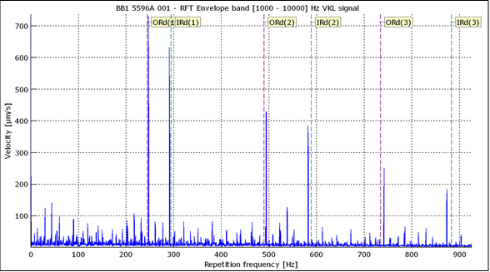
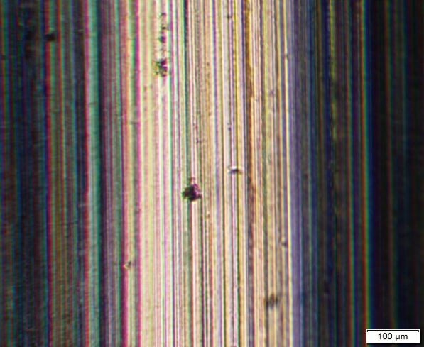
Bearing signals after dismounting and visual inspection of the bearings
L1 enveloppe signal (RFT)
The signal depicts large defects on IR and OR races
Seems like IR repetitive defects on the race wich may explain the ORD harmonics and RPM side bandes in the run up signals

Slide 11
Conclusion
The varying speed test signal show Gear frequencies
The stationary speed test signal show two bearing frequencies :
L1 ORD: outer ring defect but ORD should not have RPM side-bands
L2 RED: rolling element defect but RED should have only cage side-bands
After dismounting the bearing, the signal depicts large defects on IR and OR races

